Slide 1
How to build a chatbot — Amara Keller IBM Developer Advocate @MissAmaraKay
IBM Cloud: http://ibm.biz/ibmcloudchatbot Code pattern: http://ibm.biz/chatbot011718

Slide 2
Agenda
Open Discussion
Why Chatbots
Guts of a chatbot
Hands-On
Follow Up Topics/Homework
Notes:
If anyone is on the fence about chatbots, I can briefly discuss the UX differences between filling out a form/using a wizard and a chatbot.

Slide 3
Why chatbots?
Automatic solutions are simply more scalable.
Its cheaper, more efficient, and often more accurate than a human.
New way for engaging customers while they complete their tasks.
Notes:
Think about building an FAQ.

Slide 4
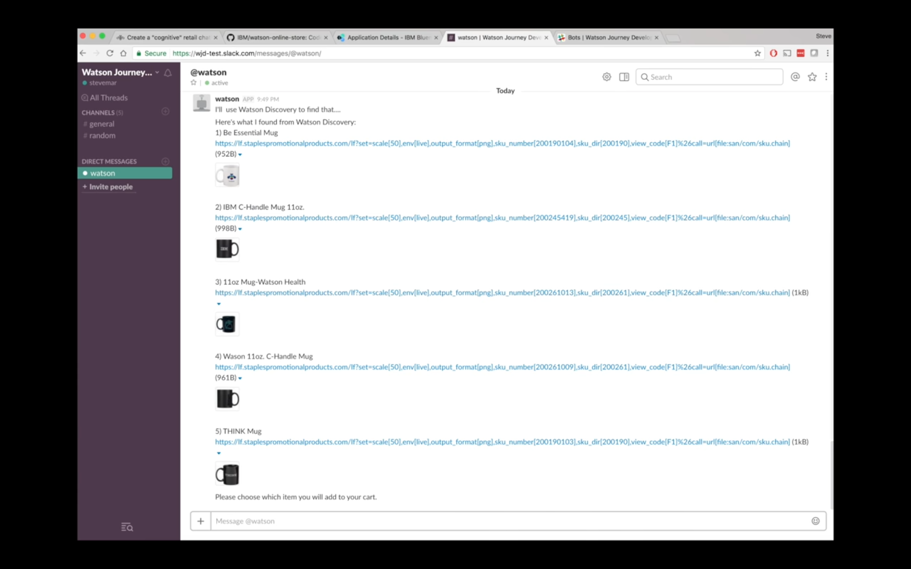
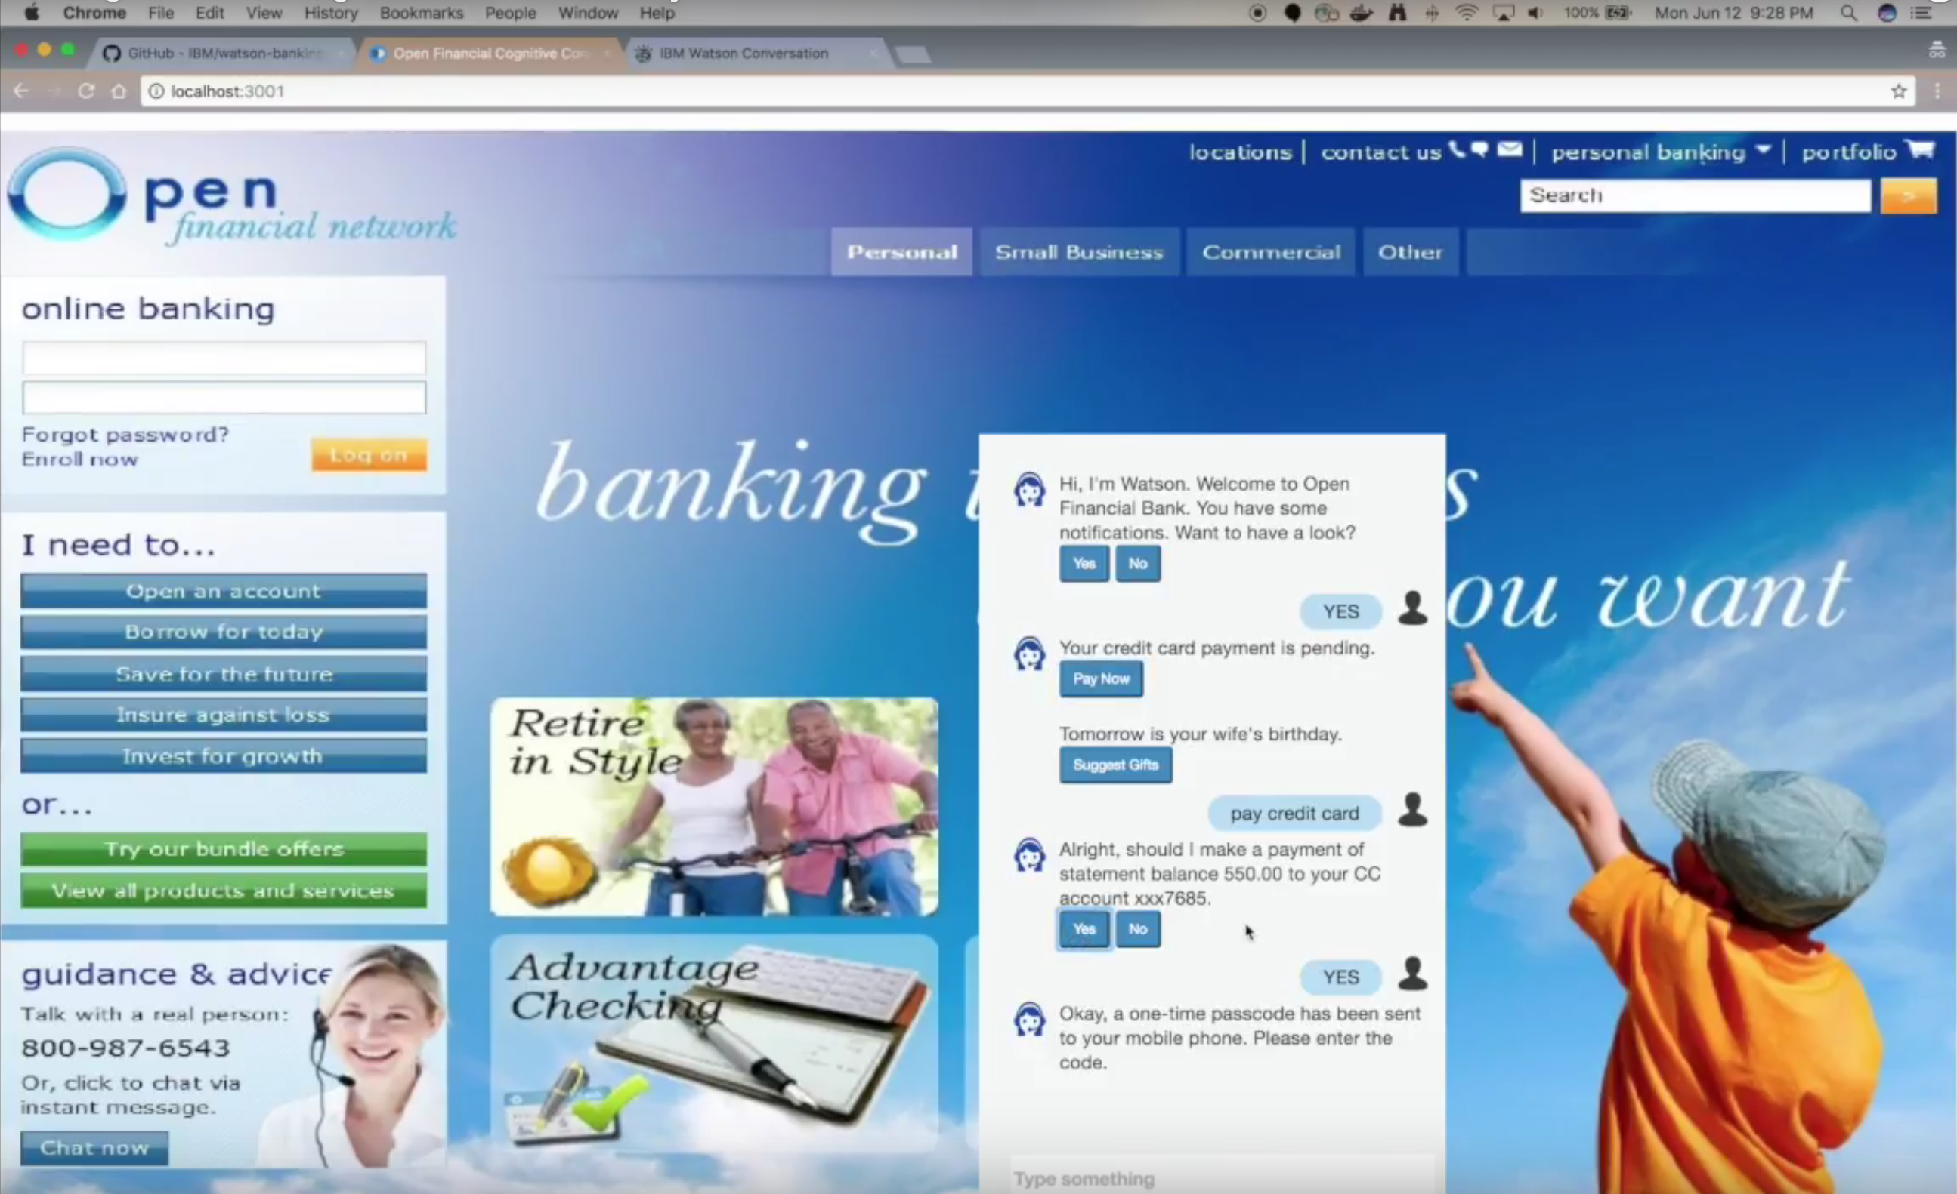

Slide 5
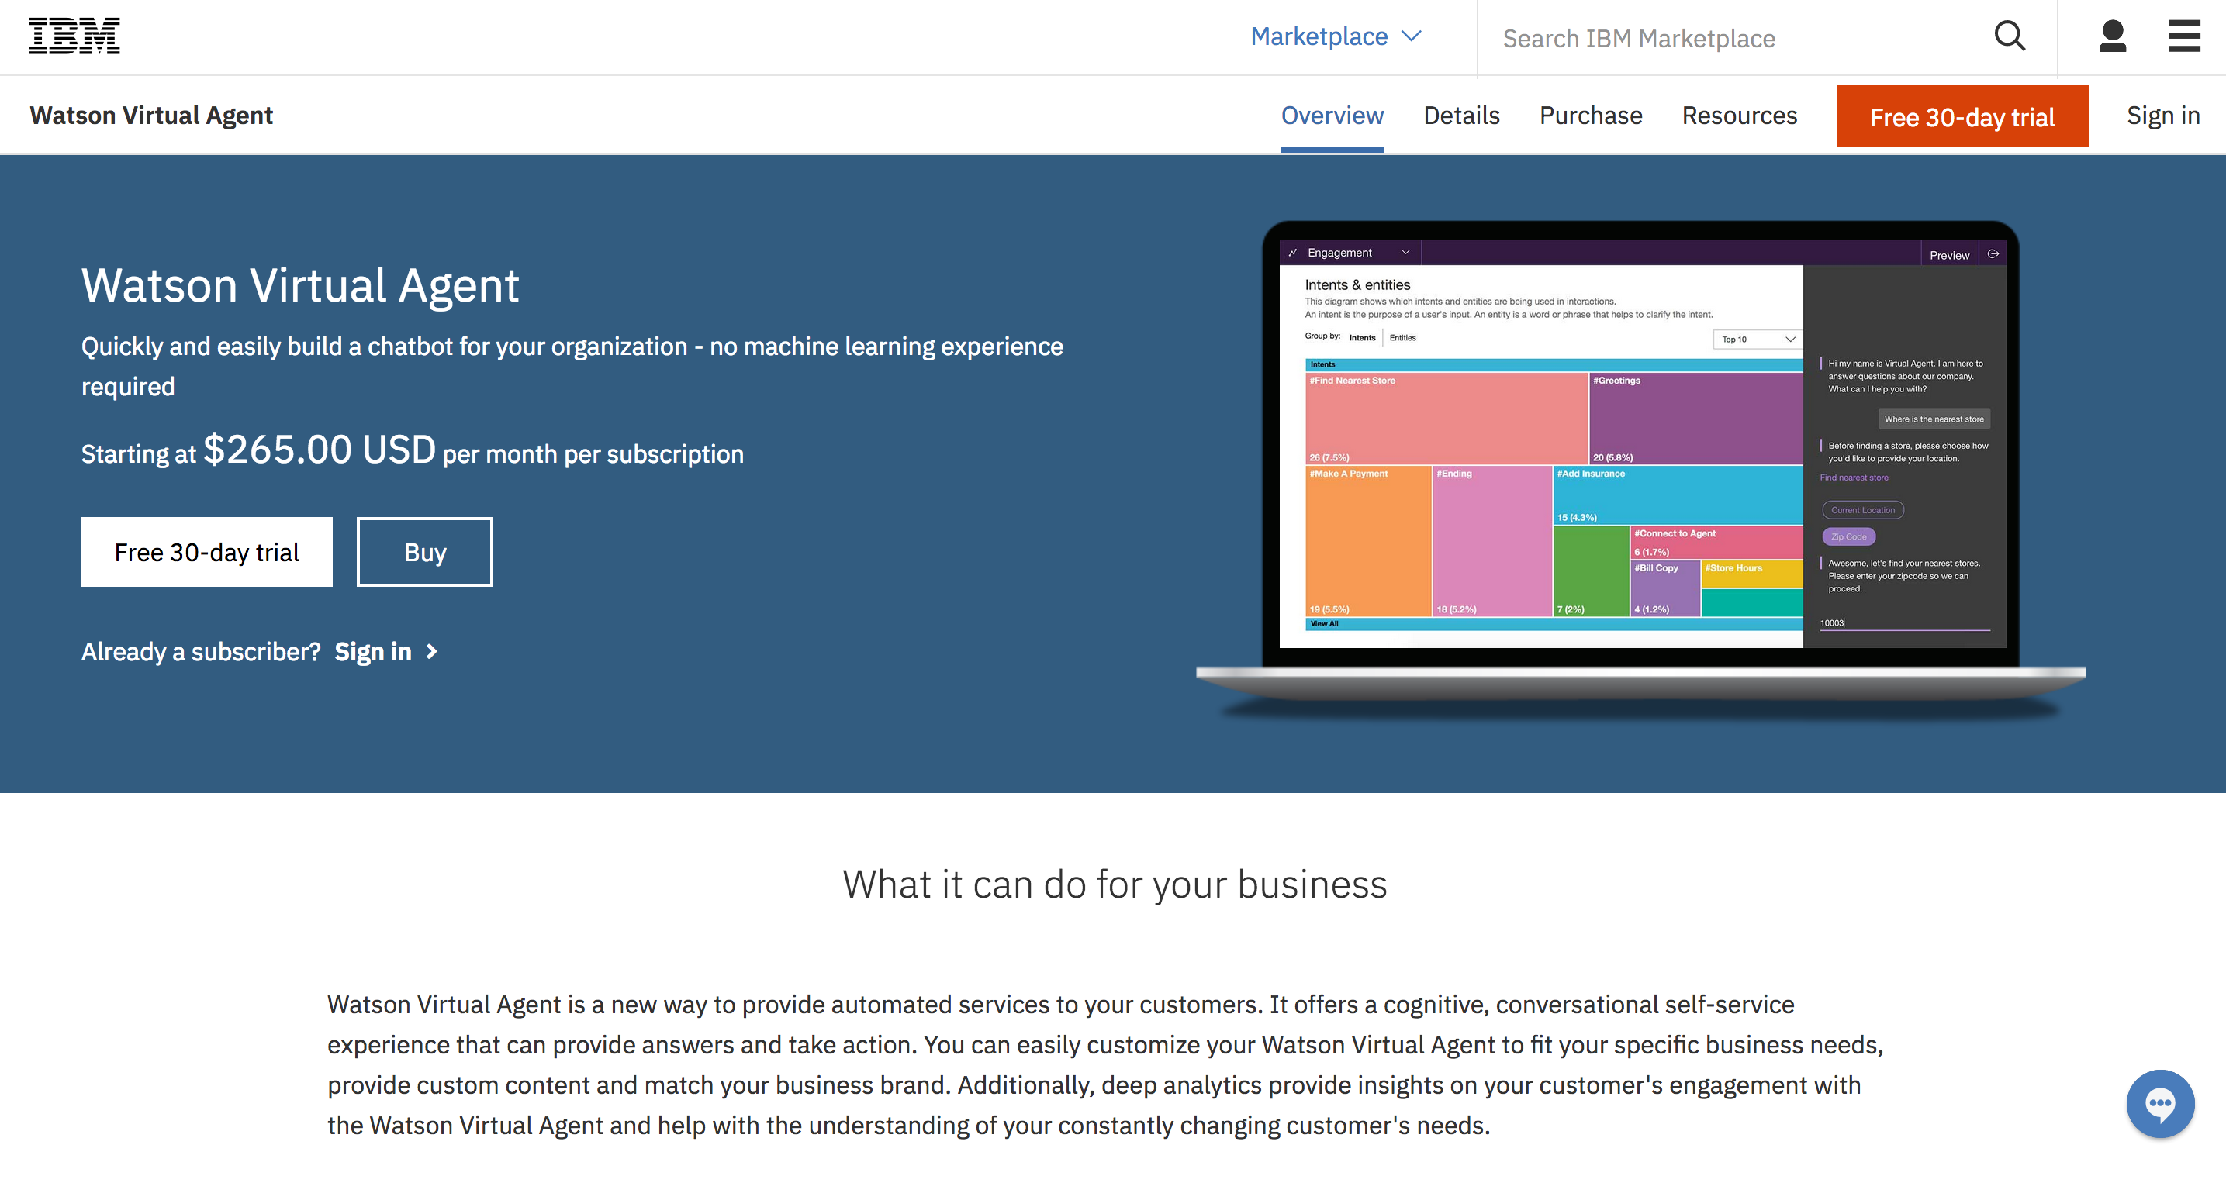
Notes:
Pre-trained virtual agents
https://www.ibm.com/us-en/marketplace/cognitive-customer-engagement

Slide 6
Guts of a chatbot
Intents
Entities
Dialog

Slide 7
#Intents
An intent is the goal or purpose of the user’s input.
Notes:
An intent is a purpose or goal expressed in a customer's input, such as answering a question or processing a bill payment.

Slide 8
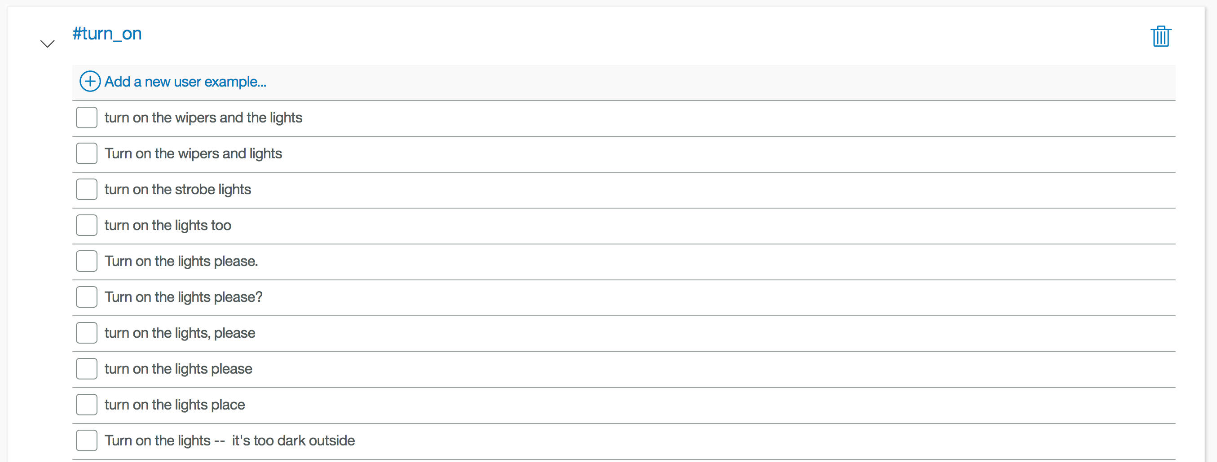
Provide at least five examples for each intent.

Slide 9
@Entities
An entity is a portion of the user’s input that you can use to provide a different response to a particular intent.
Notes:
An entity represents a class of object or a data type that is relevant to a user's purpose. By recognizing the entities that are mentioned in the user's input, the Conversation service can choose the specific actions to take to fulfill an intent.

Slide 10
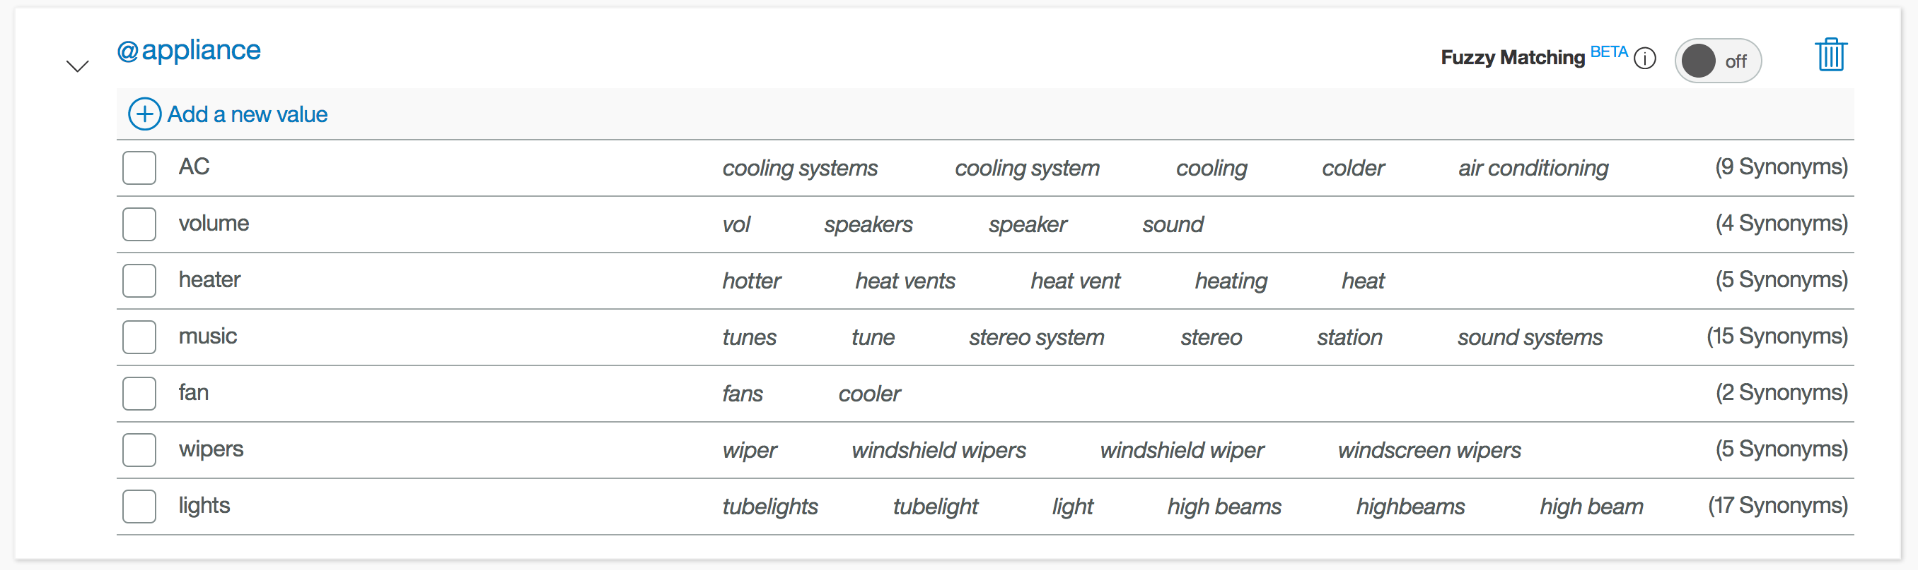
Can use synonyms (like above) or regex patterns.

Slide 11
Dialog
A dialog uses intents, entities, and context from your application to return a response to each user’s input.

Slide 12
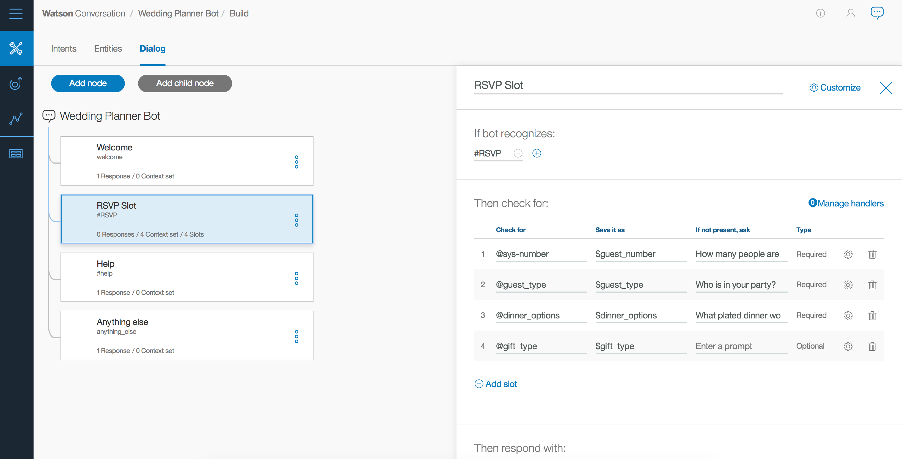

Slide 13
Now you try it!

Slide 14
Messaging Platform
Watson Conversation
2. Parse Intents and Entities
3. Application decides if further action is needed
1. Capture user input
7. Return a response with dynamic data inserted into response.
3b/8. Return response back to user and wait for another user input to repeat process
6. Update context and send to Watson
Application
Third-party API
4. Make API call to get data or perform third-party action
5. Return dynamic data

Slide 15
Thank you
Amara Keller
Developer Advocate
—
amara.keller@ibm.com
@MissAmaraKay

Slide 17
Additional Links
https://developer.ibm.com/code/journey/create-an-investment-management-chatbot/
https://developer.ibm.com/code/journey/create-cognitive-retail-chatbot/
https://developer.ibm.com/code/journey/create-cognitive-banking-chatbot/
https://developer.ibm.com/code/patterns/assemble-a-pizza-ordering-chatbot-dialog/
https://medium.com/@MissAmaraKay

